Slide 1

Strange Behaviors in JS
typeof null
returns Object even though null is a primitive data type
"IJSE".toLowerCase()
var number1 = 10;
number1.toFixed(2);
Do primitive types have methods and properties in JS ?

Slide 2


Slide 3
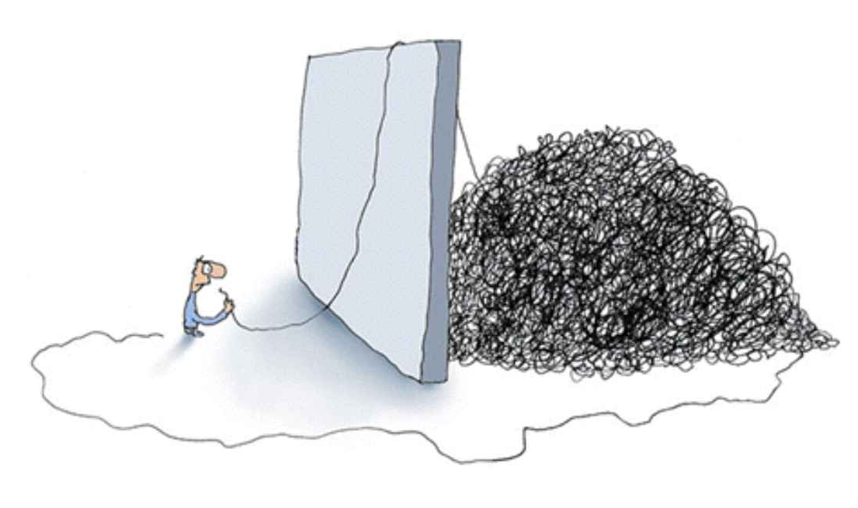
What is jQuery ?
jQuery is a JavaScript Framework which helps to manipulate the DOM easily .
So when dealing with the DOM, don't try to seperate jQuery as something you inject externaly. Instead, try to see it as a something that has attached with the DOM already.
So, if you use DOM, you do it through the jQuery.
Since jQuery, This is how we see DOM
jQuery
Real DOM

Slide 4
It is time to download :-)
http://jquery.com/

Slide 5

jQuery is all about
RS
But if you want, you can change it to
:)

Slide 6
Basic jQuery Usage
.
Then do whatever you want to do with it
( '#div1>ul>li' )
It is identical to how we use selectors to select elements in CSS

Slide 7
jQuery Documentation
http://api.jquery.com/

Slide 8
4 - "Most Used" jQuery Functions
text ( [ value ] )
html ( [ value ] )
css ( property, [ value ] )
attr (attribute, [ value ] )

Slide 9
Forms and jQuery
val ( [ value ] )
submit ()

Slide 10
Traversing & Manipulation
"Commonly Used" Traversing & Manipulation Functions
Traversing
Manipulation
append
prepend
clone
remove
replaceWith
children| find
parent | parents
first
last

Slide 11
Events
Global Events
https://developer.mozilla.org/en-US/docs/Web/API/GlobalEventHandlers
Specified Events
Event Name
Usage :-
$ ( " #btnLogin " ) . on ( " click " , function_name ) ;
Remeber, this function has "Event Data" parameter

Slide 12
More about Events - I
We can attach multiple functions to handle a single event.
$ ( " #btnLogin " ) . on ( " click " , function_1 ) ;
$ ( " #btnLogin " ) . on ( " click " , function_2 ) ;
We can also deattach functions from an event.
$ ( " #btnLogin " ) . off ( " click " ) ;
$ ( " #btnLogin " ) . off ( " click ", function_1 ) ;

Slide 13
More about Events - II
jQuery has formalized some frequently used events for ease in use.
click(function)
dblclick(function)
foucs(function)
blur(function)
keydown(function)
keyup(function)
keypress(function)
mousedown(function)
mouseup(function)
mousemove(function)

